Slide 1
Liquid Based SLA -Stereolithography Apparatus
Commonly known as Stereolithography
Process Physics - Photo polymerization

Slide 2
Polymerization
It is the process of curing a plastic or polymer by introducing a catalyst.
Polymerization links small molecule (monomers) to create a larger chain molecules (polymers), this finally develops into fully cross-linked solid chain.
Notes:
Curing:: the process of becoming hard or solid by cooling or drying

Slide 3
Polymerization
Polythene is produced by the polymerisation of molecules of ethene in the presence of a metal-based catalyst. The double bond linking the two carbon atoms (black) in ethene is broken, forming a new single bond (red) between the atoms.

Slide 4
Process of SLA- Photo Polymerization
The process of curing the polymer by introducing light as a catalyst.
Epoxy- The primary build material for stereolithography systems.
Epoxy thermo-set resins replaced the original acrylate resins.
Thermoset epoxy resins have superior thermal and mechanical properties as well as dimensional stability due to chemical cross-link networks.
Notes:
Acrylate resin was very brittle.

Slide 5
Principle
Stereolithography is a “vat polymerization” 3D printing process; liquid, photosensitive resin is poured into a vat (or tank), and UV light interacts with the resin to selectively polymerize (i.e., cure, solidify) it.
The UV light cures the resin layer by layer until the final object is complete. The thickness of each layer is called layer thickness or height. In stereolithography, layer height is typically around 50µm – about as thin as a human hair – but can be as small as 10µm. In general, the thinner the layers, the better the quality, and the longer the print times.

Slide 6
SLA Method

Slide 7
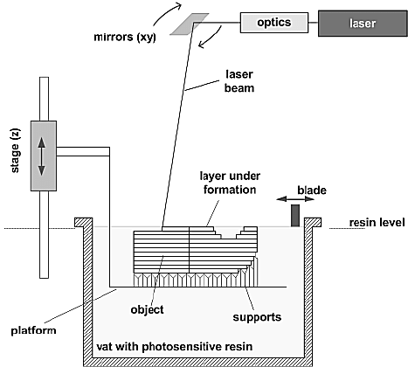
Stereolithography Process
• The process begins with a 3D CAD file.
• The file is digitally sliced into a series of parallel horizontal cross-sections which are then provided to a StereoLithography Apparatus (SLA) one at a time.
• A laser traces the cross-section onto a bath of photopolymer resin which solidifies the cross-section.
• The part is lowered a layer thickness into the bath and additional resin is swept onto the surface (typically about 0.1 mm) .
• The laser then solidifies the next cross-section.
• This process is repeated until the part is complete.
• Once the model is complete, the platform rises out of the vat and the excess resin is drained.
• The model is then removed from the platform, washed of excess resin, and then placed in a UV oven for a final curing.

Slide 8
The Light Source
Various types of radiation may be used to cure photopolymers, including gamma rays, X-rays, electron beams, UV, and in some cases visible light.
﻿﻿In SL systems, UV and visible light radiation are used most commonly.

Slide 9
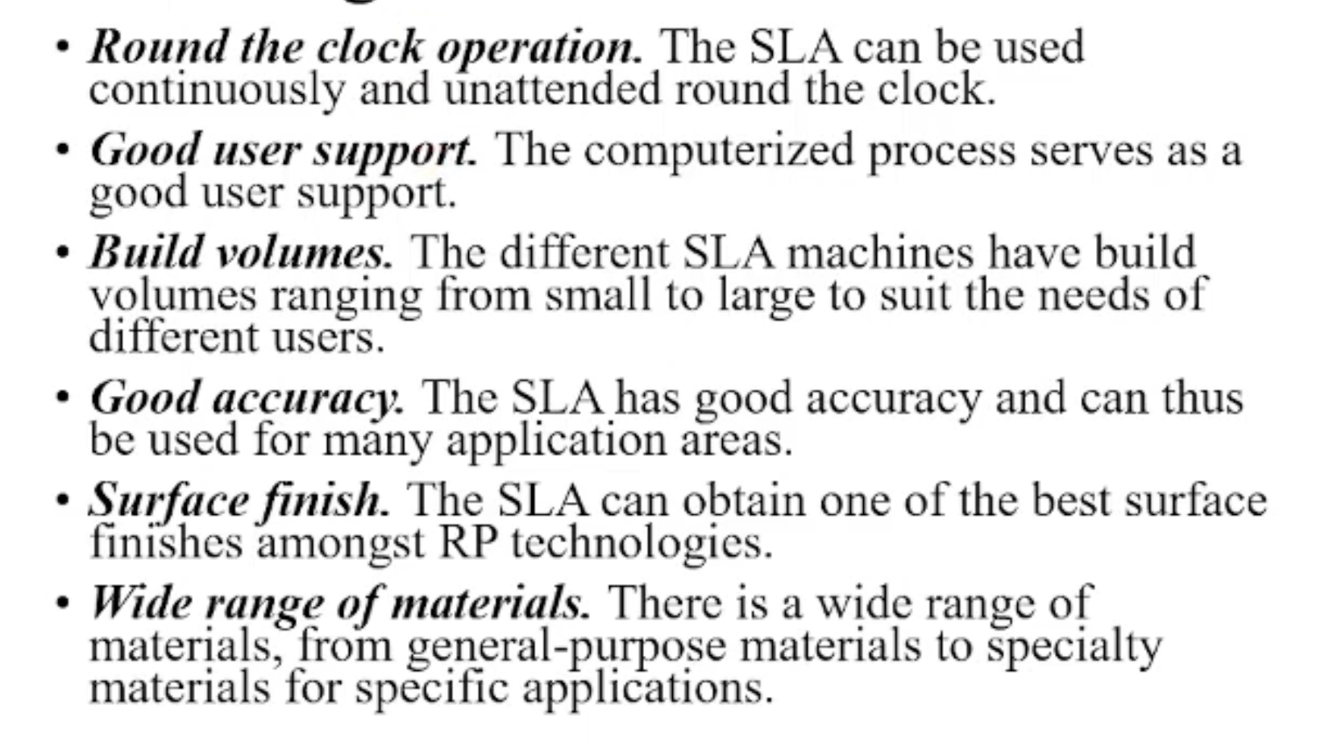
Advantages

Slide 10
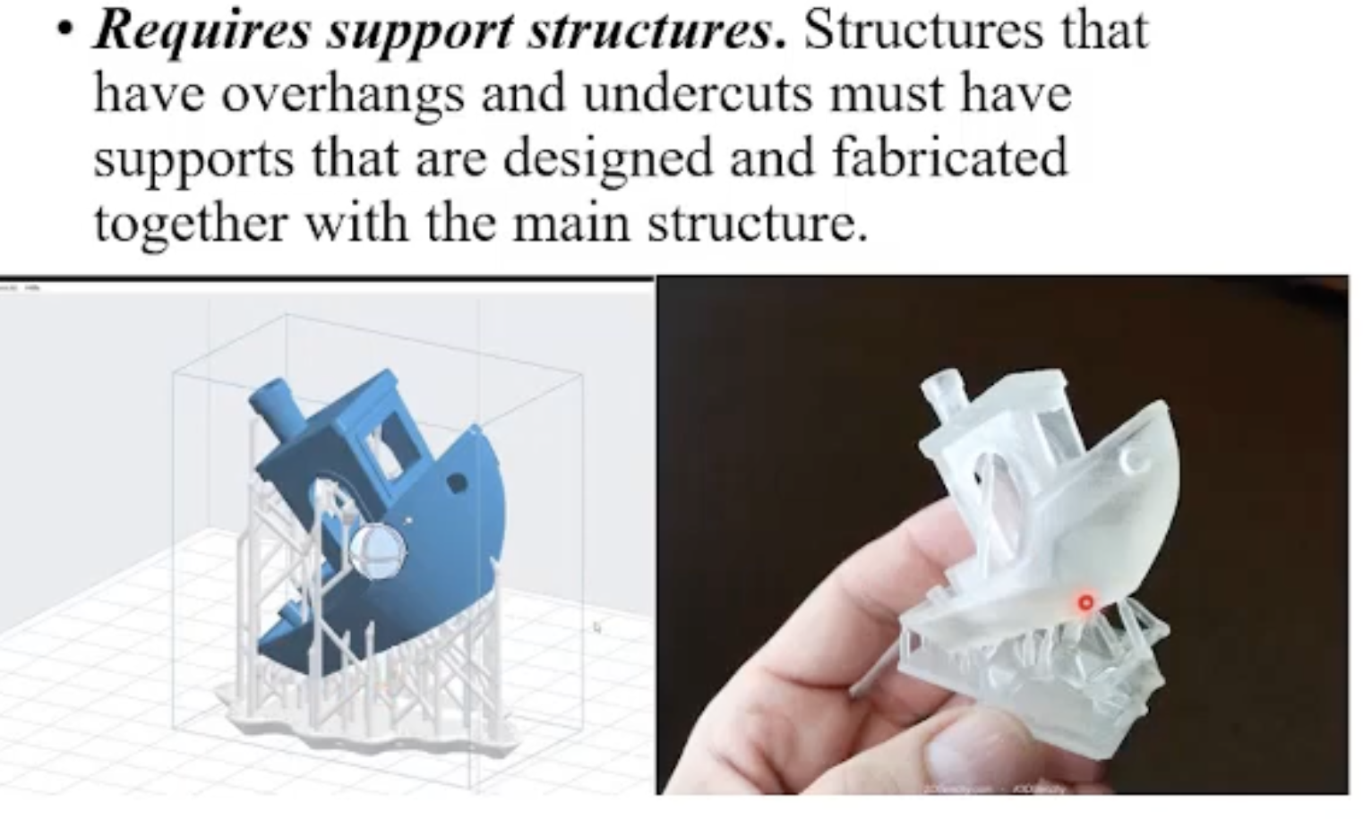
Disadvantages

Slide 11
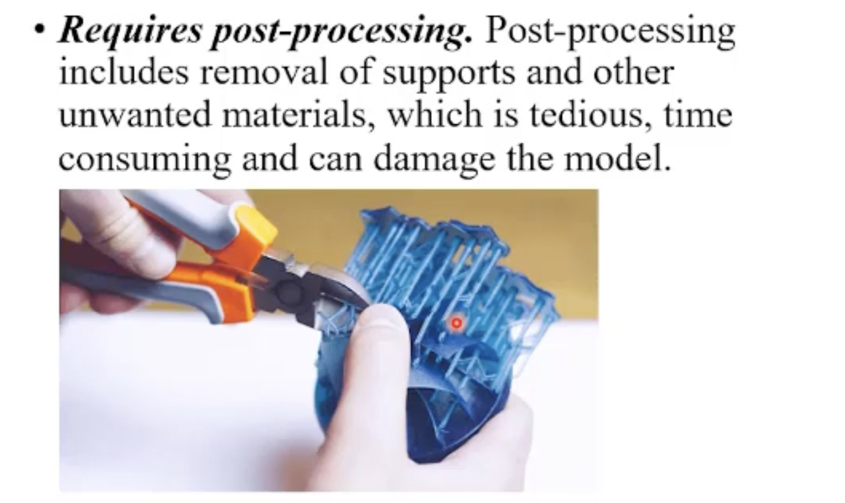
Disadvantages

Slide 12
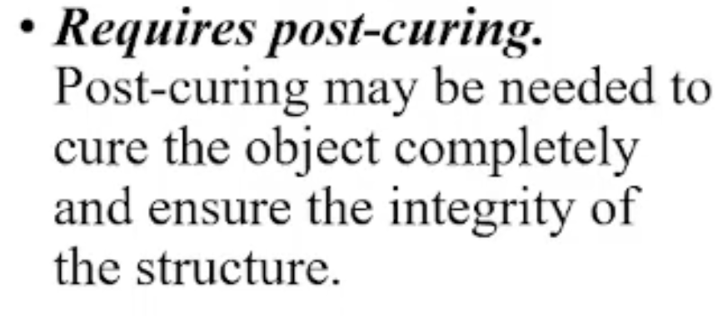
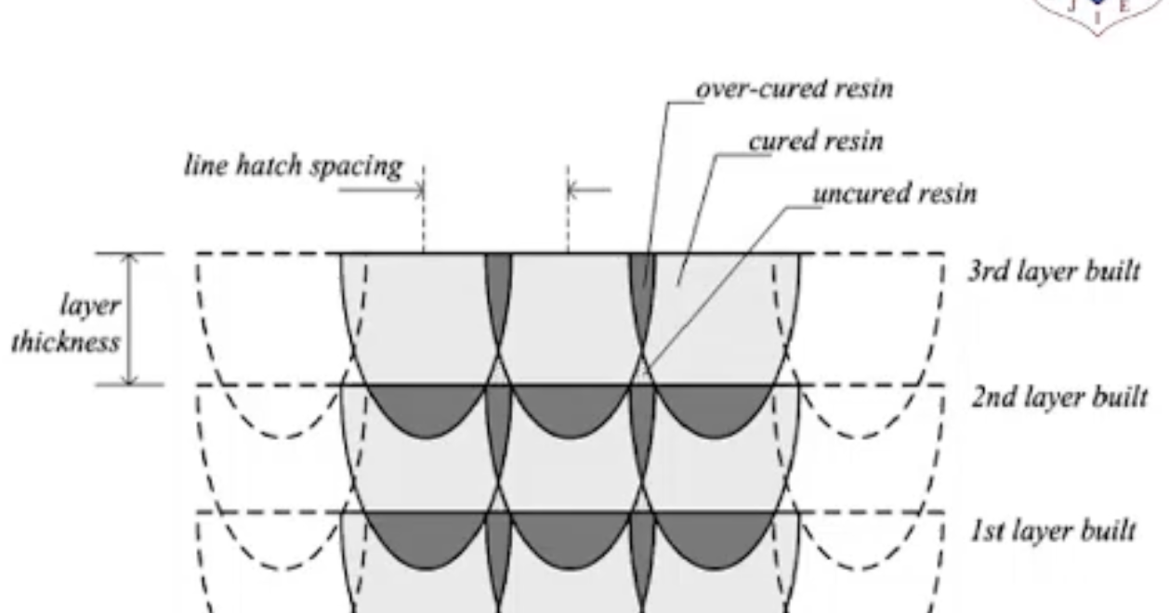
Disadvantages

Slide 13
Powder Based… SLS - Selective Laser Sintering

Slide 14
SLS - Selective Laser Sintering
Selective laser sintering (SLS) is an additive manufacturing (AM) technique that uses a laser as the power and heat source to sinter powdered material (typically nylon or polyamide), aiming the laser automatically at points in space defined by a 3D model, binding the material together to create a solid structure.

Slide 15
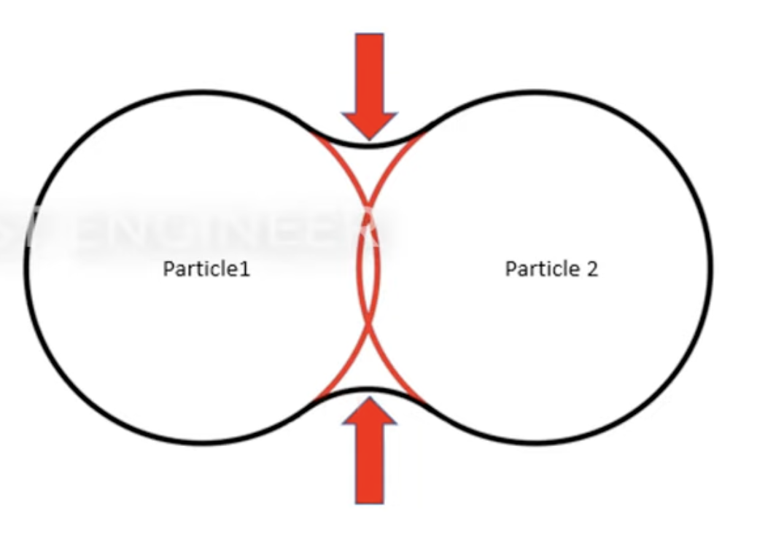
Sintering
Sintering or frittage is the process of compacting and forming a solid mass of material by pressure or heat without melting it to the point of liquefaction. Sintering happens as part of a manufacturing process used with metals, ceramics, plastics, and other materials.

Slide 16
Principle
SLS is a type of powder bed fusion (PBF) 3D printing technology. In SLS, a high-power laser draws each layer into a bed of powder, usually Nylon. The laser sinters the powder particles together to form solid structures. Once a layer is complete, the build plate lowers slightly, and a powder recoater spreads new powder onto the previous layer. This technology is highly precise, with layer thicknesses typically ranging between 50 and 200 microns.
Once the prints are complete, the machine operator must remove and de-powder them. It is possible to recycle most of the unused powder by mixing it into fresh powder; which is another advantage of SLS.

Slide 17
Materials
SLS 3D printers mainly use thermoplastic polymers in powder form, of which the most common and versatile material family is PA (polyamide), a.k.a. nylon. The standard PA-based powder can accommodate additives like aluminium, carbon fibre, and glass fibre.
Other SLS-compatible powders include TPE (thermoplastic elastomer) and TPU (thermoplastic polyurethane), rubber-like plastics, and PP (polypropylene), a chemical-resistant material.

Slide 18
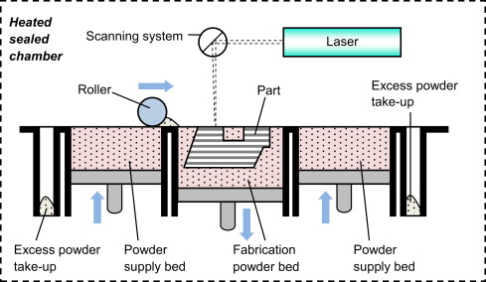
Selective Laser Sintering- Process
https://www.youtube.com/watch?v=te9OaSZ0kf8

Slide 19
Solid Based LOM –Laminated Object Manufacturing

Slide 20
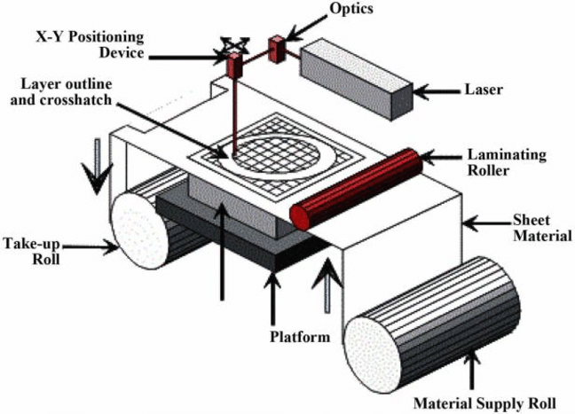
Laminated Object Manufacturing

Slide 21
Advantages:
One of the main advantages of LOM is its low cost and high speed.
LOM uses inexpensive and widely available materials, such as paper, that do not require special storage or handling.
LOM also produces models with high accuracy and resolution, as the laser or the knife can cut fine details and complex shapes.
LOM models are also strong and durable, as the layers are firmly bonded together.
LOM can also create large models, as the size is limited only by the roll of material and the machine.
Disadvantages:
Despite its advantages, LOM also has some drawbacks and limitations.
One of the main challenges of LOM is that it produces a lot of waste, as the excess material from the sheets has to be cut off and discarded.
LOM also has a limited range of colors and textures, as it depends on the type and quality of the sheets used.
LOM models may also suffer from warping, curling, or delamination, due to the thermal expansion and contraction of the layers.
LOM models may also have visible seams or gaps between the layers, which may affect their aesthetics and performance.

